Slide 1
Data Structure and Algorithm
Course code: cs-201
Topic: stack and its operations

Slide 2
Goal for today
To introduce :
Stacks
Algorithms for insertion and deletion in stacks
Applications of stacks

Slide 3
CLO Covered
CLO 2: Apply and design various data structures methods for specified applications. GA4

Slide 4
Stacks
There are certain frequent situations in computer science when one wants to restrict insertion and deletions so that they can take place only at the beginning or at the end not in the middle.
Stack (LIFO)
Queue (FIFO)
These are actually conditions on linked list and linear arrays.

Slide 5
Stack
“A Stack is a special kind of list in which all insertions and deletions take place at one end, called the Top”
Other Names
Pushdown List
Last In First Out (LIFO)
5

Slide 6
Stack
It is called as stack because it behaves like a real-world stack, piles of books, etc.
A Stack is an abstract data type with a pre-defined capacity, which means that it can store the elements of a limited size.
Stores a set of elements in a particular order
It is a data structure that follows some order to insert and delete the elements, and that order can be
LIFO (Last – In – First – Out)
FILO (First – In – Last – Out)
6

Slide 7
Stack
Stack principle: LAST IN FIRST OUT= LIFO
It means: the last element inserted is the first one to be removed
Which is the first element to pick up?

Slide 8
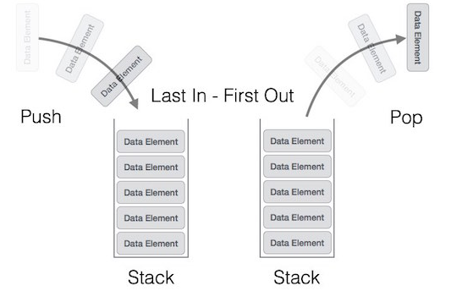
Stack
Two basic operations are associated with Stack
Push : Insert an element into a stack
Pop : Delete an element from a stack

Slide 9
Real time applications of stacks
Backtracking features:
Undo feature in word.
To previous choice point in a game.
To retrieve recently used objects in cache.

Slide 10

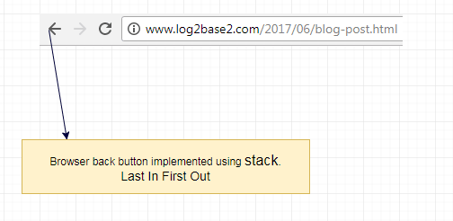
Stack (Examples)
10

Slide 11
Common Operations on Stacks
push(): When we insert an element in a stack then the operation is known as a push. If the stack is full then the overflow condition occurs.
pop(): When we delete an element from the stack, the operation is known as a pop. If the stack is empty means that no element exists in the stack, this state is known as an underflow state.
isEmpty(): It determines whether the stack is empty or not.
isFull(): It determines whether the stack is full or not.’
peek(): It returns the element at the given position.
display(): It prints all the elements available in the stack.
11

Slide 12
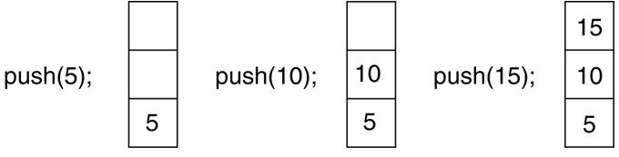
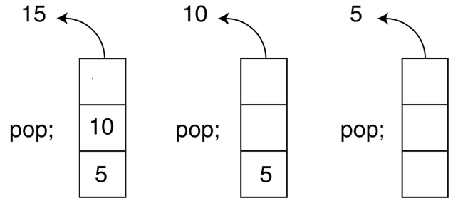
Push and Pop Operations on Stack
12

Slide 13
Stacks Representation
Stack data structure can be implemented in two ways. They are as follows...
Linear Array (Static memory allocation)
One way Linked List (Dynamic memory allocation)
13

Slide 14
Static and Dynamic Stacks
Stack using array
When a stack is implemented using an array, that stack can organize an only limited number of elements.
Static type, i.e. they have a fixed size, and are implemented as arrays.
Stack using linked list
When a stack is implemented using a linked list, that stack can organize an unlimited number of elements.
Dynamic type, i.e. they grow in size as needed, and implemented as linked lists
14

Slide 15
An Array Implementation of Stacks
First Implementation
Elements are stored in contiguous cells of an array.
New elements can be inserted to the top of the list.
maxlength
Empty
top
Last Element
List
Second Element
First Element
15

Slide 16
Array Representation of Stack
STACK
AA | BB | CC
1 | 2 | 3 | 4 | 5 | 6 | 7 | 8
TOP
3
MAXSTK
8
TOP = 0 or TOP = NULL will indicates that the stack is empty

Slide 17
An Array Implementation of Stacks
A stack data structure can be implemented using a one-dimensional array.
But stack implemented using array stores only a fixed number of data values.
This implementation is very simple. Just define a one dimensional array of specific size and insert or delete the values into that array by using LIFO principle with the help of a variable called 'top’.
Initially, the top is set to -1.
Whenever we want to insert a value into the stack, increment the top value by one and then insert.
Whenever we want to delete a value from the stack, then delete the top value and decrement the top value by one.
17

Slide 18
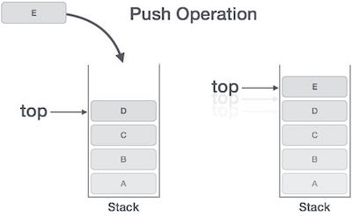
Push():Insertion in stack
if(top == MAXSIZE)
print: Overflow, Exit [ Stack already filled]
else
top = top + 1;
stack[top] = data;
18

Slide 19
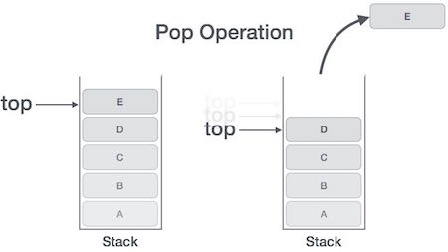
Pop():Deletion in stack
if(top == -1)
print: Underflow, Exit [ Stack is empty]
else
data = stack[top];
top = top - 1;
19

Slide 20
#include <conio.h>
#include <iostream.h>
#include <process.h>
#define STACKSIZE 10 // int const STACKSIZE = 10;
// global variable and array declaration
int Top=-1;
int Stack[STACKSIZE];
void Push(int); // functions prototyping
int Pop(void);
bool IsEmpty(void);
bool IsFull(void);
void Traverse(void);
int main( )
{ int item, choice;
while( 1 )
{
cout<< "\n\n\n\n\n";
cout<< " ******* STACK OPERATIONS ********* \n\n";
cout<< " 1- Push item \n 2- Pop Item \n";
cout<< " 3- Traverse / Display Stack Items \n 4- Exit.";
cout<< " \n\n\t Your choice ---> ";
cin>> choice;
switch(choice)
{ case 1: if(IsFull())cout<< "\n Stack Full/Overflow\n";
else
{ cout<< "\n Enter a number: "; cin>>item;
Push(item); }
break;
case 2: if(IsEmpty())cout<< "\n Stack is empty) \n";
else
{item=Pop();
cout<< "\n deleted from Stack = "<<item<<endl;}
break;
case 3: if(IsEmpty())cout<< "\n Stack is empty) \n";
else
{ cout<< "\n List of Item pushed on Stack:\n";
Traverse();
}
break;

Slide 21
case 4: exit(0);
default:
cout<< "\n\n\t Invalid Choice: \n";
} // end of switch block
} // end of while loop
} // end of of main() function
void Push(int item)
{
Stack[++Top] = item;
}
int Pop( )
{
return Stack[Top--];
}
bool IsEmpty( )
{ if(Top == -1 ) return true else return false; }
bool IsFull( )
{ if(Top == STACKSIZE-1 ) return true else return false; }
void Traverse( )
{ int TopTemp = Top;
do{ cout<< Stack[TopTemp--]<<endl;} while(TopTemp>= 0);
}

Slide 22
Stacks algorithms using linked list
Insertion
Deletion

Slide 23
Linked List Representation of Stack
TOP
Head
CC
BB
AA
X
Top Of Stack
Bottom Of Stack

Slide 24
PUSH Operation
Push operation into the stack is accomplished by inserting a node into the front of the list [Insert it as the first node in the list]
TOP
CC
BB
AA
X
PUSH DD into STACK
DD

Slide 25
PUSH Operation
STACK before PUSH Operation
TOP
CC
BB
AA
X
STACK After PUSH Operation
TOP
CC
BB
AA
X
DD

Slide 26
PUSH Operation using linked list
struct node *newnode;
newnode=(struct node*)malloc(sizeof(struct node));
newnode ->data=item; //any type of data such as number or name
newnode ->link=top;
top=newnode;

Slide 27
POP Operation
POP operation is accomplished by deleting the node pointed to by the TOP pointer [Delete the first node in the list]

Slide 28
POP Operation
STACK before POP Operation
TOP
CC
BB
AA
X
DD
STACK After POP Operation
TOP
CC
BB
AA
X

Slide 29
POP Operation using linked list
deletion from top
struct node * temp;
temp=top;
if top == null
then write underflow and exit
print: top ->data;
top=top->link;
free( temp);

Slide 30
Application of stacks
Reversal of strings.
Checking validity of brackets.
Converting infix to postfix and prefix.
Evaluating the postfix expression.

Slide 31
Your Turn
Consider the following stack of characters, where STACK is allocated N=8 memory cells:
STACK: A, C, D, F, K, __, __, __,
“__” is used to represent empty memory cells. Describe the stack as the following operations take place:
POP(STACK, ITEM)
POP(STACK, ITEM)
PUSH(STACK, L)
PUSH(STACK, P)
POP(STACK, ITEM)
PUSH(STACK, R)
PUSH(STACK, S)
POP(STACK, ITEM)
31

